Slide 1
CdmCL, a Specific Textual Constraint Language for Common Data Model
Ahmed Ahmed, Paola Vallejo, Mickaël Kerboeuf, Jean-Philippe Babau
Lab-STICC, University Of Western Brittany - France
alahmed4ever@yahoo.com,{vallejoco,kerboeuf, babau}@univ-brest.fr

Slide 2
Problem Overview (1/3)
Common Data Model (CDM)
Abstract data model for scientific datasets
General scientific data model
Network Common Data Format (.nc file)
Specific standards (OceanSITES)
A set of Constraints on CDM
Natural language
Domain specific tools
Code-oriented validation tool
CDM compliant
NetCDF file
{myData.nc}
OceanSITESConformityChecker
Not Valid
Valid
OceanSITES Manipulation Tools

Slide 3
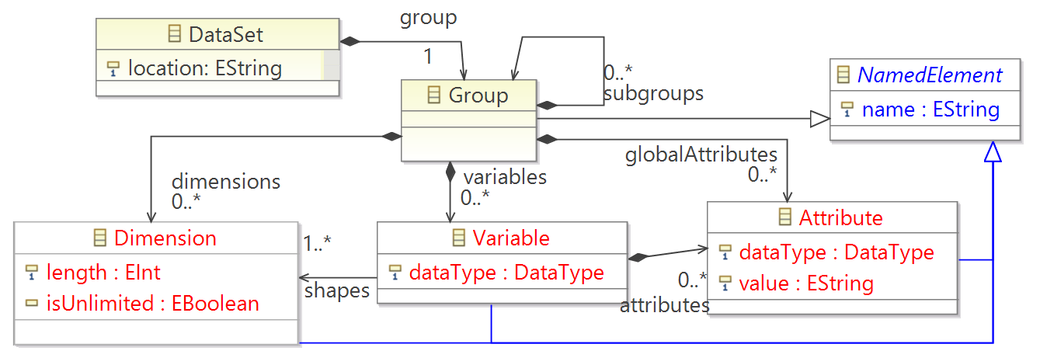
Common Data Model
Dimension: Array dimension size
Variable: Multi-dimensional array of typed data
Attribute: Meta-data
Named Concepts

Slide 4
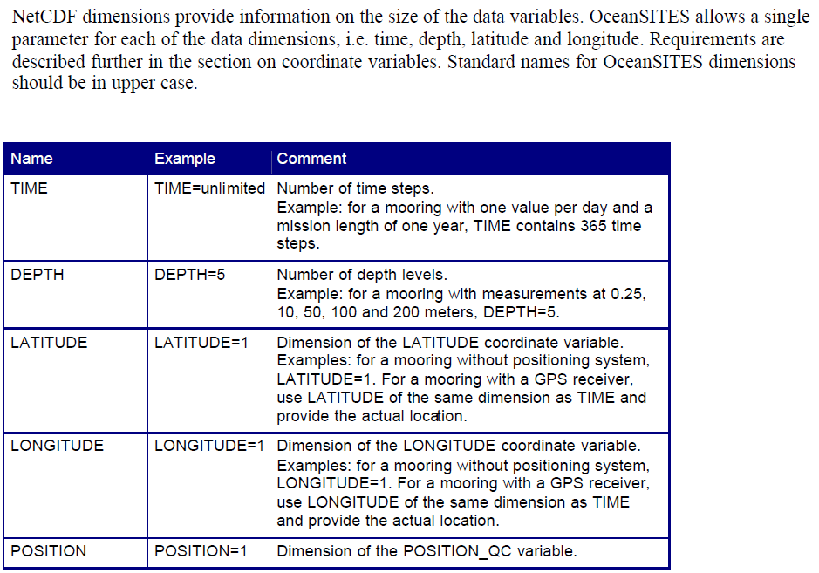
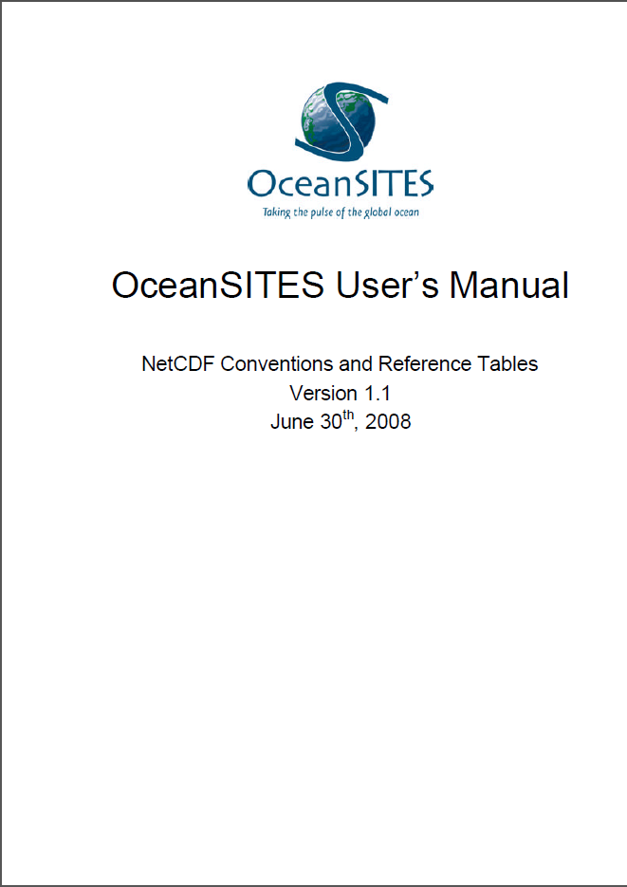
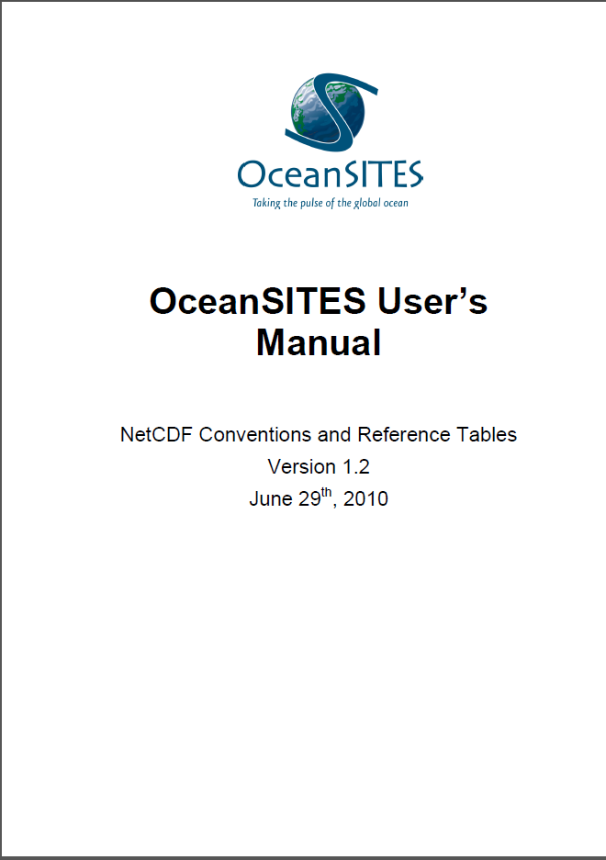
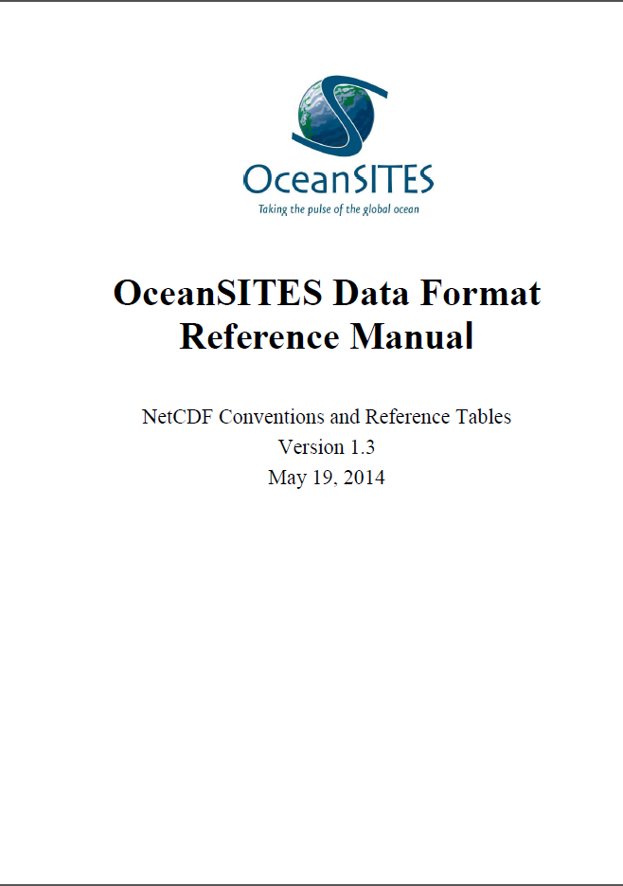
Problem Overview(2/3)
Standard:
Textual constraints
Ambiguous
Multiple Versions
Validation tool modification
Professional interference
Use formal constraint language and existing checker
OCL

Slide 5
Solution: Object Constraint Language
Mandatory Dimension
Mandatory
CDM
OCL
Dimension Length
conforms
OceanSITES Data
Variable Example
Data type
Applied to specific Named Instance
Repeated Constraint structure
Exist, Select Structure
Shape

Slide 6
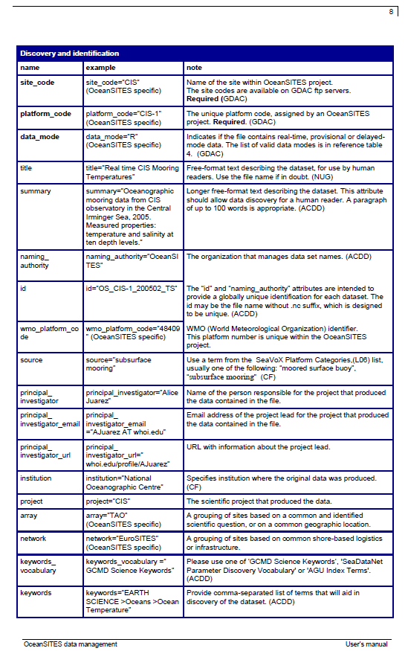
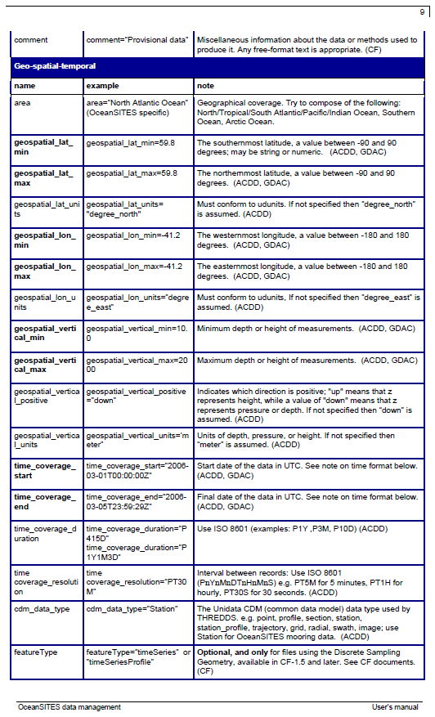
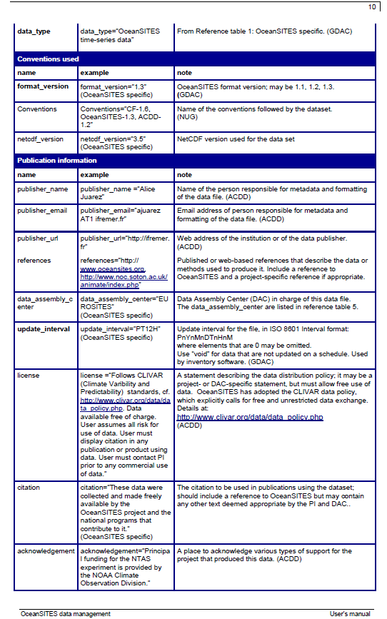
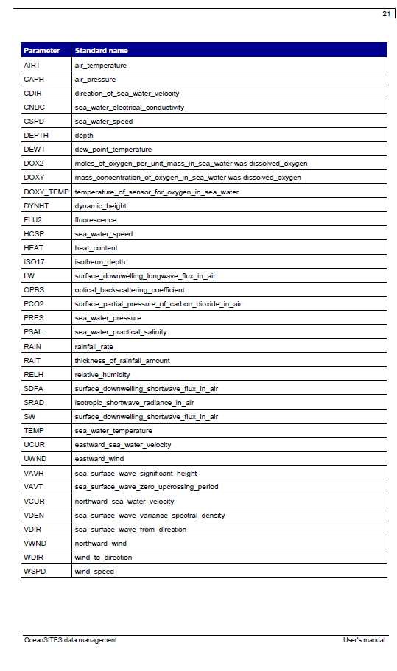
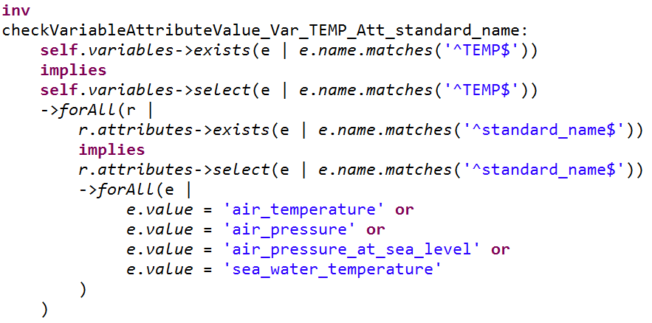
OCL Solution Problems (3/3)
Verbose Constraints
Example: Variable named TEMP holding attribute named standard_name should hold one of the values air_temperature, air_pressure, or air_pressure_at_sea_level, or sea_water_temperature

Slide 7
Problem Summary
30 pages of Textual Constraints
difficult to write correct (and read) OCL constraints
Similar repeated constraints
Exist, Select structure
Verbose
results in inaccurate and erroneous constraints
Hard for scientists
Proposal: CdmCL a domain specific constraint language for CDM

Slide 8
Outlines
Problem Overview
CdmCL language
Tooling
Conclusion

Slide 9
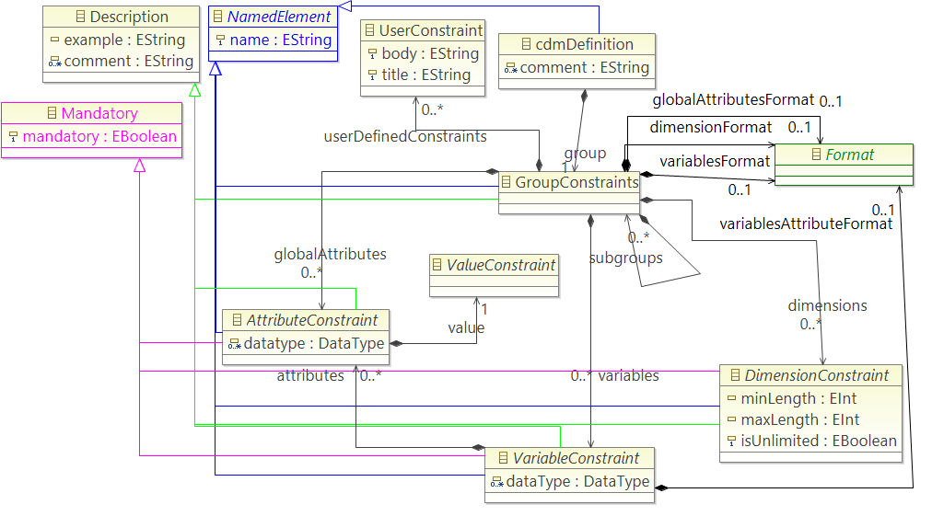
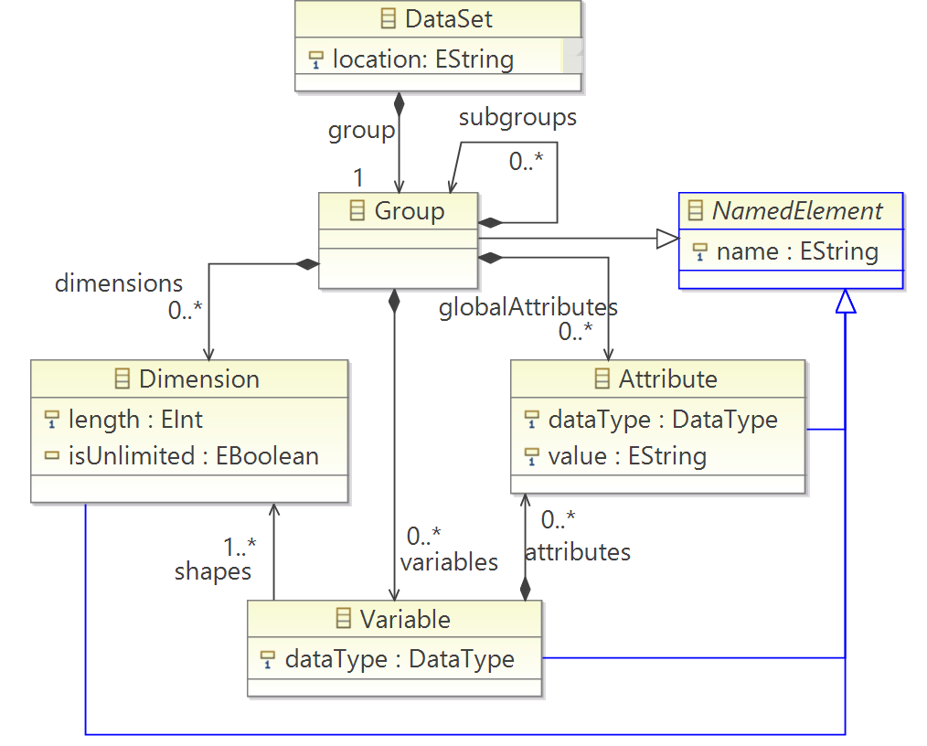
CdmCL : based on CDM
A concept constraint or a set of constraints for each CDM concept
CdmCL
CDM

Slide 10
CdmCL: CDM Constraints
Constraints are defined on features of each named CDM concepts

Slide 11
CdmCL : based on CDM
Example: Constraints on Dimension Length
CdmCL
CDM

Slide 12
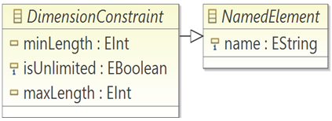
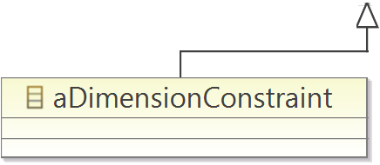
Constraint Concept Reference
A constraint is defined for a (or a set of) named instance(s) for each of the main CDM concepts
Constraints applied on:
aConceptConstraint (a specific dimension, variable, or attribute, e.g. TIME)
ConceptRegExConstraint (dimension, variable or attribute that name matches a regex, e.g DEPTH[0-9])
ConceptListConstraint (a list of dimension, variables or attributes names, e.g {TIME, DEPTH,…} )

Slide 13
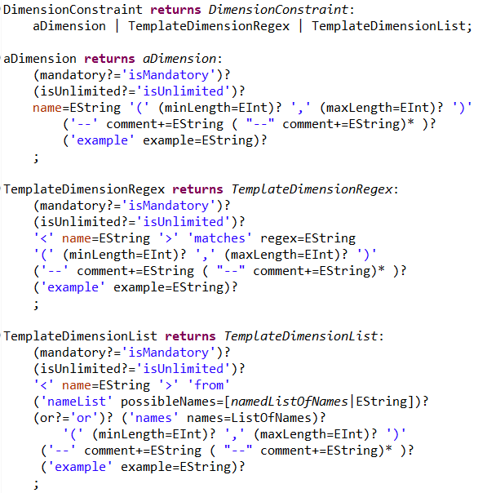
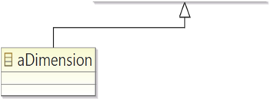
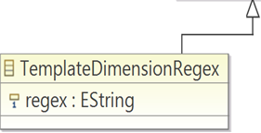
CdmCL is a language
Xtext is used to define the textual grammar
A semantic expressed in OCL

Slide 14
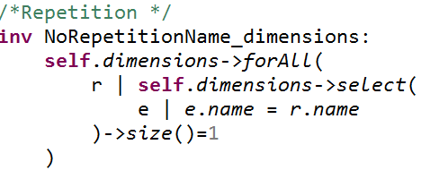
Common Constraint Categories
Not Repeated Dimensions
User Defined Constraints
Mandatory
Format
Repetition
User Defined Constraints
Constraints that are related to multiple CDM concepts at the same time
E.g. verify if there exists a variable named “TIME”, either it has an attribute named “QC_Indicator” or there exists another variable named “TIME_QC” but not both
Mandatory Global Attribute
OceanSITES
UpperCase Dimensions
OceanSITES
OceanSITES
OCL
CdmCL
CdmCL
CdmCL
OCL
OCL
OCL

Slide 15
Specific Concept Constraints(1/2)
Dimensions length
Unlimited Dimension
Variable shape
SimilarDimensionConstraint
PredefinedShape
Variable shape Repetition
Variable and Attribute Data Type
Not Repeated Variable Shape
OceanSITES
Min | Max | Description
x | x | length = x
x | y | x<= length <= y
x | -1 | x <= length
0 | y | length <= y
0 | -1 | No constraint
OCL
Global Attribute
OceanSITES
CdmCL
OCL

Slide 16
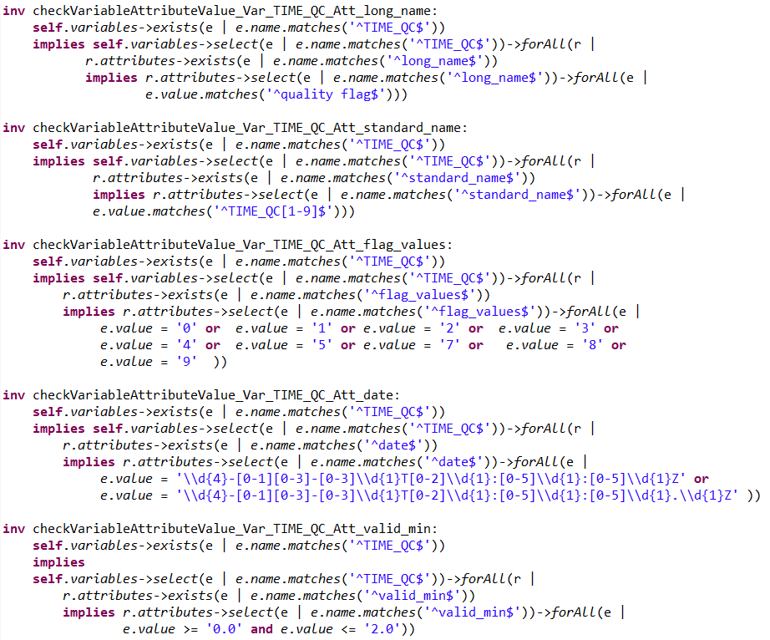
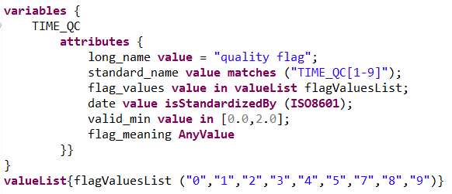
Specific Concept Constraints(2/2)
Attribute Value
Unique Value
Regular expression
Possible Values
Standard (ISO8601)
YYYY-MM-DDThh:mm:ssZ OR
YYYY-MM-DDThh:mm:ss.sZ
Range (min, max)
OCL
CdmCL

Slide 17
Outlines
Problem Overview
CdmCL language
Tooling
Conclusion

Slide 18
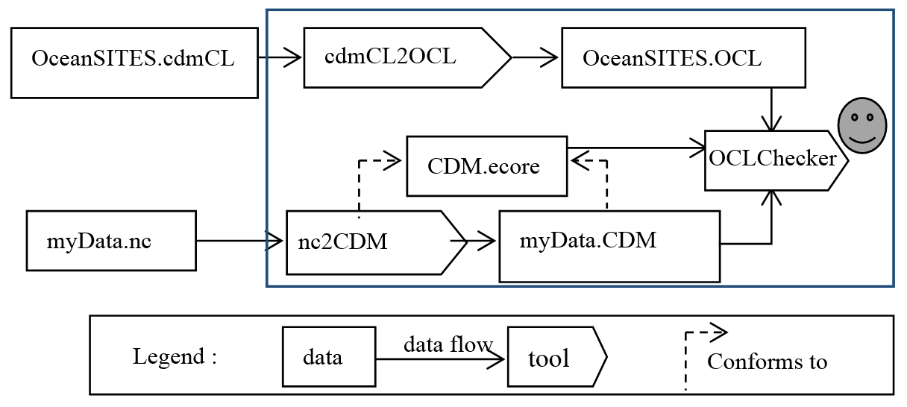
Tool Architecture
NetCDF to CDM Translator
CDM generated code (EMF)
NetCDF API
CdmCL to OCL Translator
Xtext API
Our Transformation Library (CdmCL2OCL)
OCL Checker
EMF Validation Framework

Slide 19
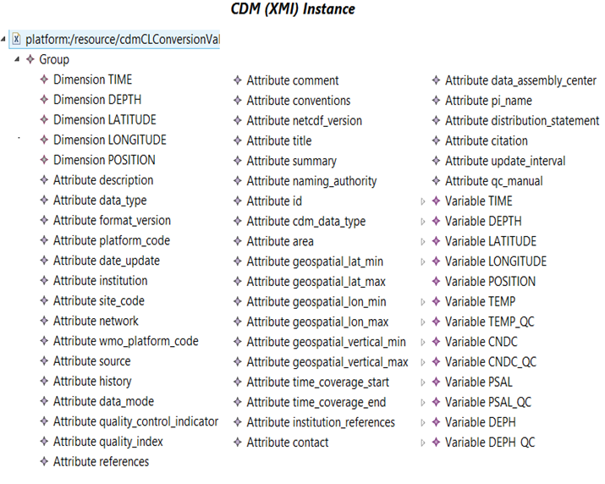
TOOLING (1/3): NetCDF2CDM transformation
Dimensions
Variables
Global Attributes

Slide 20
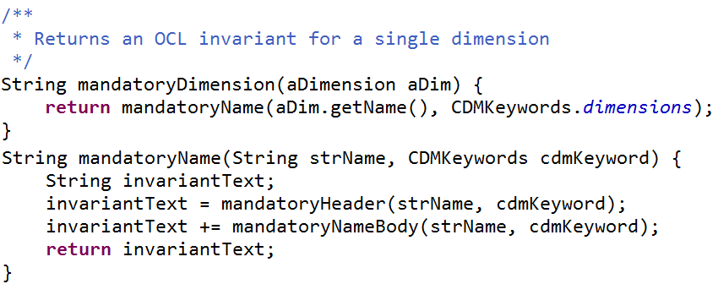
TOOLING (2/3): CdmCl2OCL Transformation
Mandatory Dimension TIME
Create invariant header
Create invariant body
Create OCL File
Header
Body

Slide 21
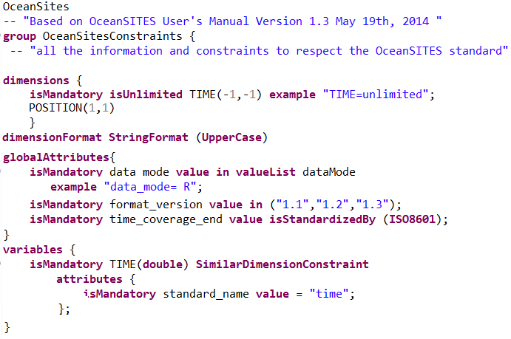
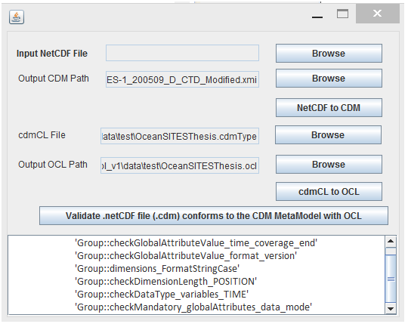
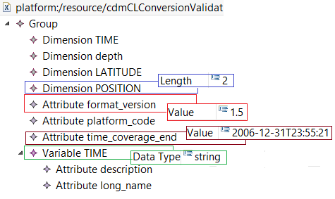
TOOLING (3/3): Validation (Invalid FILE)
Tool
OceanSITES CdmCL
CDM Instance
Missing Mandatory Global Attribute

Slide 22
Outlines
Problem Overview
CdmCL language
Tooling
Conclusion

Slide 23
CONCLUSION
CdmCL : A Domain Specific Constraint Language for CDM
Human readable
Close to natural language
Meetings with standard users and writer (IRD, IFREMER)
tool developers
90% of constraints achieved
Unachieved constraints -> User Defined Constraints
Hide OCL complexity (50 line in CdmCL -> 400 line in OCL)
One conformity checker tool for any standard

Slide 24
Future Works
Error tracing
Based on CdmCL, debugging facilities
Migration tools
From different standards or different versions of a standard
Serialization format
Import and export
Data verification
CdmCL extension
Document Generation for Standards

Slide 25
Thanks

